Slide 1

Spring Framework
Radu rusu & Razvan ceuca

Slide 2

What is Spring Framework?
The Spring Framework is an open-source back-end web-application framework and inversion of control container designed for the Java platform.
1 October 2002
Rod Johnson
Apache 2.0 license

Slide 3
Why Spring?
Flexible Trusted Libraries
Build any kind of application
Microservices
Fast execution
Great security
Enormous community

Slide 4
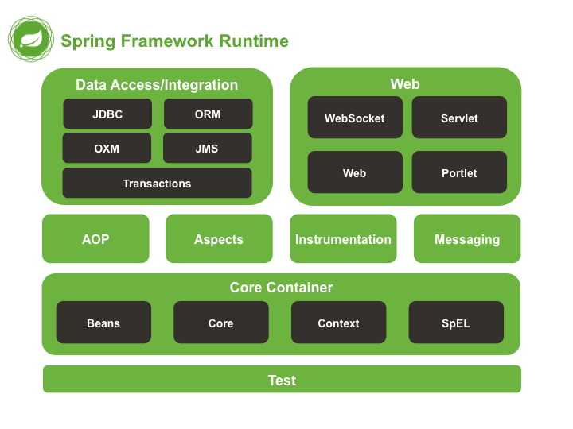
Spring Framework’s Modules

Slide 5
Spring Core Technologies
Dependency Injection
Events
Resource Interface
Validation
Data binding
Type conversion
SpEL
AOP

Slide 6
Dependency Injection
class Employee{
Address address;
Employee(Address address){
this.address=address;
}
public void setAddress(Address address){
this.address=address;
}
}
What is dependency injection? Spring framework provides two ways to inject dependency:
By Setter method
By Constructor

Slide 7

Resource Interface
What does Spring’s Resource Interface do??

Slide 8
Resource Interface
public interface Resource extends InputStreamSource {
boolean exists();
boolean isOpen();
URL getURL() throws IOException;
File getFile() throws IOException;
Resource createRelative(String relativePath) throws IOException;
String getFilename();
String getDescription();
}
public interface InputStreamSource {
InputStream getInputStream() throws IOException;
}

Slide 9
Validation
When it comes to validating user input, Spring Boot provides strong support for this common, yet critical, task.
@Entity
public class User {
@Id
@GeneratedValue(strategy = GenerationType.AUTO)
private long id;
@NotBlank(message = "Name is mandatory")
private String name;
@NotBlank(message = "Email is mandatory")
private String email;
// standard constructors / setters / getters / toString
}

Slide 10
Validation
@Repository
public interface UserRepository extends CrudRepository<User, Long> {}
@RestController
public class UserController {
@PostMapping("/users")
ResponseEntity<String> addUser(@Valid @RequestBody User user) {
// persisting the user
return ResponseEntity.ok("User is valid");
}
// standard constructors / other methods
}

Slide 11
Validation
The @ExceptionHandler annotation allows us to handle specified types of exceptions through one single method. Therefore, we can use it for processing the validation errors:
@ResponseStatus(HttpStatus.BAD_REQUEST)
@ExceptionHandler(MethodArgumentNotValidException.class)
public Map<String, String> handleValidationExceptions( MethodArgumentNotValidException ex) {
Map<String, String> errors = new HashMap<>();
ex.getBindingResult().getAllErrors().forEach((error) -> {
String fieldName = ((FieldError) error).getField();
String errorMessage = error.getDefaultMessage();
errors.put(fieldName, errorMessage); });
return errors;
}

Slide 12
Type Conversion
What is Type Conversion?
Why do we need Type Conversion?

Slide 13
Type Conversion – Built-in Converters
@Autowired
ConversionService conversionService;
@Test
public void whenConvertStringToIntegerUsingDefaultConverter_thenSuccess() {
assertThat(
conversionService.convert("25", Integer.class)).isEqualTo(25);
}

Slide 14
Type Conversion – Creating a Custom Converter
Let's have a look at an example of converting a String representation of an Employee to an Employee instance.
Here's the Employee class:
public class Employee {
private long id;
private double salary;
// standard constructors, getters, setters
}
public class StringToEmployeeConverter
implements Converter<String, Employee> {
@Override
public Employee convert(String from) {
String[] data = from.split(",");
return new Employee(
Long.parseLong(data[0]),
Double.parseDouble(data[1]));
}
}

Slide 15
Type Conversion – Creating a Custom Converter
@Configuration
public class WebConfig implements WebMvcConfigurer {
@Override
public void addFormatters(FormatterRegistry registry) {
registry.addConverter(new StringToEmployeeConverter());
}
}
@Test
public void whenConvertStringToEmployee_thenSuccess() {
Employee employee = conversionService
.convert("1,50000.00", Employee.class);
Employee actualEmployee = new Employee(1, 50000.00);
assertThat(conversionService.convert("1,50000.00",
Employee.class))
.isEqualToComparingFieldByField(actualEmployee);
}

Slide 16
SpEL
Type | Operators
Arithmetic | +, -, *, /, %, ^, div, mod
Relational | <, >, ==, !=, <=, >=, lt, gt, eq, ne, le, ge
Logical | and, or, not, &&, ||, !
Conditional | ?:
Regex | matches
What is SpEL?

Slide 17
SpEL - Examples
@Value("#{20 - 1}") // 19
private double subtract;
@Value("#{10 * 2}") // 20
private double multiply;
@Value("#{1 == 1}") // true
private boolean equal;
@Value("#{1 != 1}") // false
private boolean notEqual;
@Value("#{250 > 200 && 200 < 4000}") // true
private boolean and;
@Value("#{400 > 300 || 150 < 100}") // true
private boolean or;
@Value("#{2 > 1 ? 'a' : 'b'}") // "a"
private String ternary;
@Value("#{'100' matches '\\d+' }") // true
private boolean validNumericStringResult;

Slide 18
SpEL – Real Case Example
We will create a simple Spring Boot application and create the employee.properties file in the resources directory.
employee.names=Petey Cruiser,Anna Sthesia,Paul Molive,Buck Kinnear
employee.type=contract,fulltime,external
employee.age={one:'26', two : '34', three : '32', four: '25’}
Create a class EmployeeConfig as follows:
@Configuration
@PropertySource (name = "employeeProperties", value = "employee.properties")
@ConfigurationProperties
public class EmployeeConfig {
}
To get only the first entry from a list of employee names we can write the expression as follows:
@Value ("#{'${employee.names}'.split(',')[0]}")
private String firstEmployeeName;

Slide 19
Events
What Are Events in Spring Framework?
Why Should I Use Events Instead of Direct Method Calls?
What is an Application Event?

Slide 20
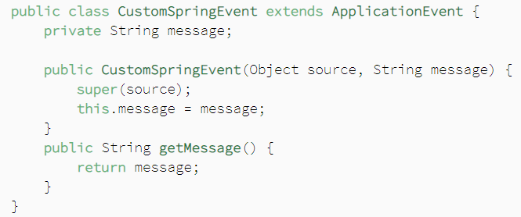
Events – Event

Slide 21
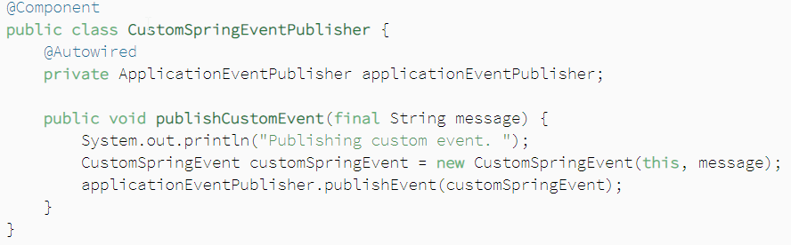
Events – Publisher

Slide 22
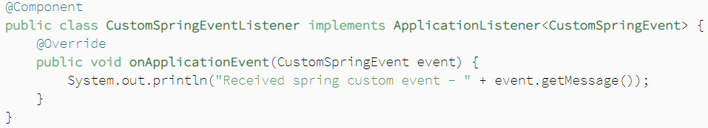
Events – Listener

Slide 23
Aspect Oriented Programming (AOP)
What is AOP?
Modularity in AOP

Slide 24
Aspect Oriented Programming (AOP) - Terminologies
Aspect
Join Point
Advice
Pointcut
Introduction
Target Object
Weaving

Slide 25

Questions?

